Slide 1
Data Centric RAD
Bachelor of Science (Honours) in Computing in Software Development
Bachelor of Science in Computing in Software
Development
Department of Computer Science & Applied Physics

Slide 2
Review of MySQL
What are the problems with the following table structure?
Superhero_Table
Name* | City* | Real_First_Name | Real_Surname | dob | powers
Spiderman | New York | Peter | Parker | 1980-01-27 | 71.04
Superman | Metropolis | Clark | Kent | 1980-11-22 | 99.00
Batman | Gotham City | Bruce | Wayne | 1960-11-12 | 97.45
Spiderman | Metropolis | Peter | Parker | 1980-01-27 | 71.04
Batman | Metropolis | Bruce | Wayne | 1960-11-12 | 97.45
Batgirl | Gotham City | Barbara | Gordon | 1995-12-07 | 98.05
Radioactiveman | Springfield | Alan | Jones | 2000-07-04 | 76.88

Slide 3
Review of MySQL
We want to organise data efficiently and reduce the potential for data anomalies.
This is called Normalization.

Slide 4
Normalization
“Normalization is the process of organizing the columns (attributes) and tables (relations) of a relational database to minimize data redundancy”.
Normalization organises data efficiently
Normalization reduces the potential for data anomalies

Slide 5
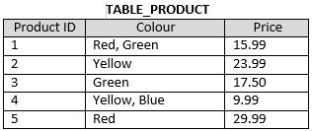
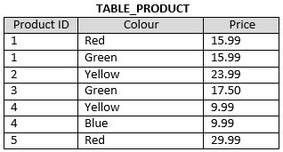
Normal Forms – 1NF
A Database is in 1st Normal Form if it:
Contains only atomic values (there are no repeating groups)
0 NF
1 NF
PK = ProductID
PK = ProductID, Colour

Slide 6
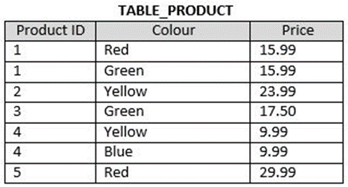
Normal Forms – 2NF
A Database is in 2nd Normal Form if:
It is in 1NF
Every non-key attribute is fully functionally dependent on the entire key
PK = ProductID, Colour

Slide 7
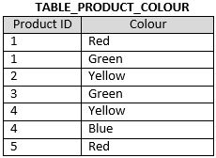
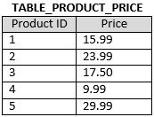
Normal Forms – 2NF
1 NF
PK = ProductID, Colour
2 NF
PK = ProductID, Colour
PK = ProductID

Slide 8
Normal Forms – 3NF
A Database is in 3rd Normal Form if:
It is in 2NF
There is no transitive functional dependency
Functional Dependence
B is dependent on A
C is dependent on B
Therefore C is transitively dependent on A

Slide 9
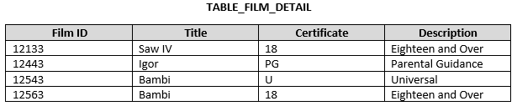
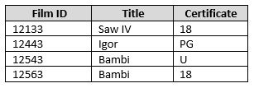

Normal Forms – 3NF
2 NF
PK = Film ID
3 NF
PK = Film ID
PK = Certificate

Slide 10
1 NF
Superhero_Table
Name* | City* | Real_First_Name | Real_Surname | dob | powers
Spiderman | New York | Peter | Parker | 1980-01-27 | 71.04
Superman | Metropolis | Clark | Kent | 1980-11-22 | 99.00
Batman | Gotham City | Bruce | Wayne | 1960-11-12 | 97.45
Spiderman | Metropolis | Peter | Parker | 1980-01-27 | 71.04
Batman | Metropolis | Bruce | Wayne | 1960-11-12 | 97.45
Batgirl | Gotham City | Barbara | Gordon | 1995-12-07 | 98.05
Radioactiveman | Springfield | Alan | Jones | 2000-07-04 | 76.88
2 NF
Superhero_City_Table
Name* | City*
Spiderman | New York
Superman | Metropolis
Batman | Gotham City
Spiderman | Metropolis
Batman | Metropolis
Batgirl | Gotham City
Radioactiveman | Springfield
Superhero_Table
Name* | Real_First_Name | Real_Surname | dob | powers
Spiderman | Peter | Parker | 1980-01-27 | 71.04
Superman | Clark | Kent | 1980-11-22 | 99.00
Batman | Bruce | Wayne | 1960-11-12 | 97.45
Batgirl | Barbara | Gordon | 1995-12-07 | 98.05
Radioactiveman | Alan | Jones | 2000-07-04 | 76.88
References

Slide 11
Foreign Keys
The Foreign Key is a column in one table that references a column in another table.
The referenced column is usually the Primary Key column.
The Foreign Key ensures Referential Integrity

Slide 12
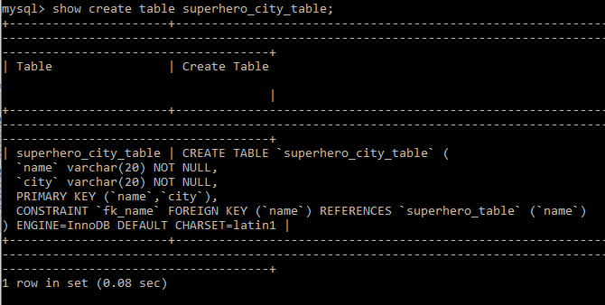
Foreign Key
You can see the Foreign Keys in a Table using the show create table <table> command
Refers to column in this table
Refers to other table
Refers to column in other table

Slide 13
Foreign Keys
What happens if we try to delete Spiderman from the Superhero_Table?
Superhero_City_Table
Name* | City*
Spiderman | New York
Superman | Metropolis
Batman | Gotham City
Spiderman | Metropolis
Batman | Metropolis
Batgirl | Gotham City
Radioactiveman | Springfield
References
Superhero_Table
Name* | Real_First_Name | Real_Surname | dob | powers
Spiderman | Peter | Parker | 1980-01-27 | 71.04
Superman | Clark | Kent | 1980-11-22 | 99.00
Batman | Bruce | Wayne | 1960-11-12 | 97.45
Batgirl | Barbara | Gordon | 1995-12-07 | 98.05
Radioactiveman | Alan | Jones | 2000-07-04 | 76.88

Slide 14
Foreign Keys – On Delete
3 Options when the Referenced Foreign Key is Deleted:
Restrict
The Referenced FK cannot be deleted.
This is the default.
Cascade
The Row Referencing the FK to be deleted is also deleted.
Set NULL
The FK is set to NULL.
Not allowed for Primary Keys.

Slide 15
Foreign Keys – On Delete
Superhero_Table
Name* | Real_First_Name | Real_Surname | dob | powers
Spiderman | Peter | Parker | 1980-01-27 | 71.04
Superman | Clark | Kent | 1980-11-22 | 99.00
Batman | Bruce | Wayne | 1960-11-12 | 97.45
Batgirl | Barbara | Gordon | 1995-12-07 | 98.05
Radioactiveman | Alan | Jones | 2000-07-04 | 76.88
On Delete Cascade
Superhero_City_Table
Name* | City*
Spiderman | New York
Superman | Metropolis
Batman | Gotham City
Spiderman | Metropolis
Batman | Metropolis
Batgirl | Gotham City
Radioactiveman | Springfield

Slide 16
Foreign Keys – On Delete
Superhero_Table
Name* | Real_First_Name | Real_Surname | dob | powers
Spiderman | Peter | Parker | 1980-01-27 | 71.04
Superman | Clark | Kent | 1980-11-22 | 99.00
Batman | Bruce | Wayne | 1960-11-12 | 97.45
Batgirl | Barbara | Gordon | 1995-12-07 | 98.05
Radioactiveman | Alan | Jones | 2000-07-04 | 76.88
On Delete Restrict
Superhero_City_Table
Name* | City*
Spiderman | New York
Superman | Metropolis
Batman | Gotham City
Spiderman | Metropolis
Batman | Metropolis
Batgirl | Gotham City
Radioactiveman | Springfield

Slide 17
Foreign Keys – On Delete
Superhero_Table
Name* | Real_First_Name | Real_Surname | dob | powers
Spiderman | Peter | Parker | 1980-01-27 | 71.04
Superman | Clark | Kent | 1980-11-22 | 99.00
Batman | Bruce | Wayne | 1960-11-12 | 97.45
Batgirl | Barbara | Gordon | 1995-12-07 | 98.05
Radioactiveman | Alan | Jones | 2000-07-04 | 76.88
On Delete Set NULL
Superhero_City_Table
Name* | City*
Spiderman | New York
Superman | Metropolis
Batman | Gotham City
Spiderman | Metropolis
Batman | Metropolis
Batgirl | Gotham City
Radioactiveman | Springfield

